Slide 2
Henshaw Park
Community Input Session
November 2, 2023

Slide 3
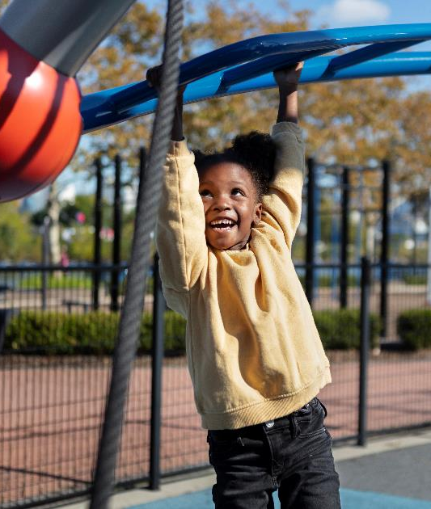
We want to hear from you!
What sort of park amenities are you interested in?
Paths
Playgrounds
Trees and landscaping
Themes?
Natural, modern, etc…?
Shade?
Access points?
Bathrooms?
What other ideas do you have?

Slide 4
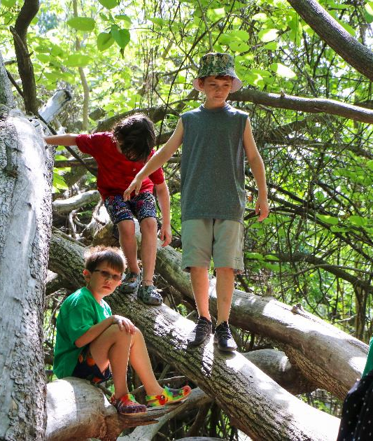
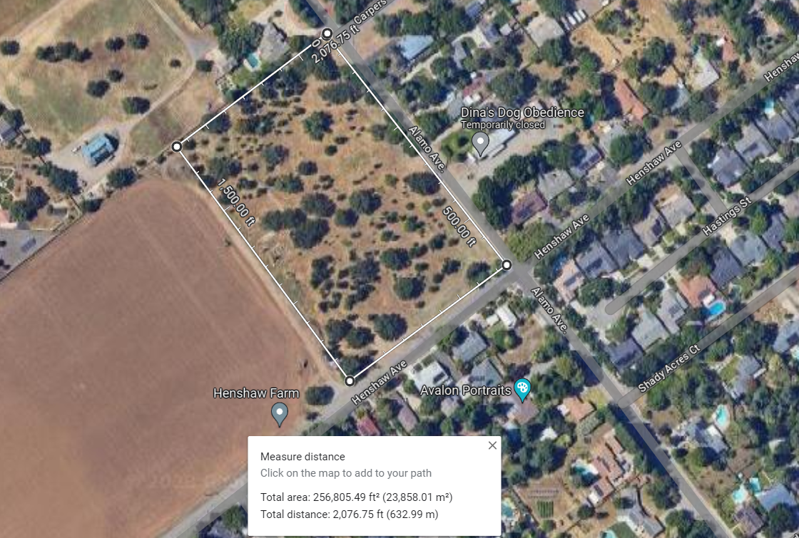
Henshaw Park Site
5.5 acres

Slide 5
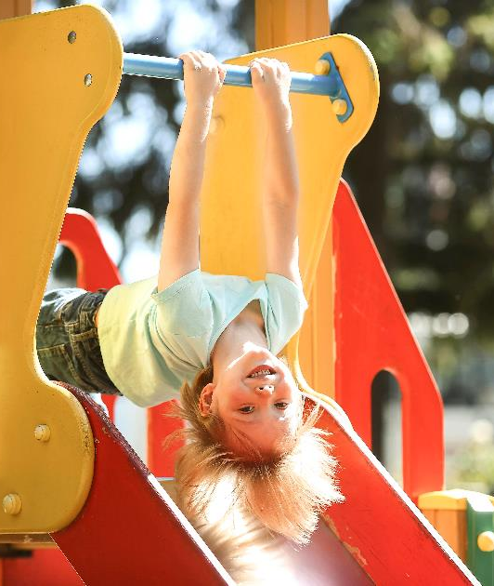
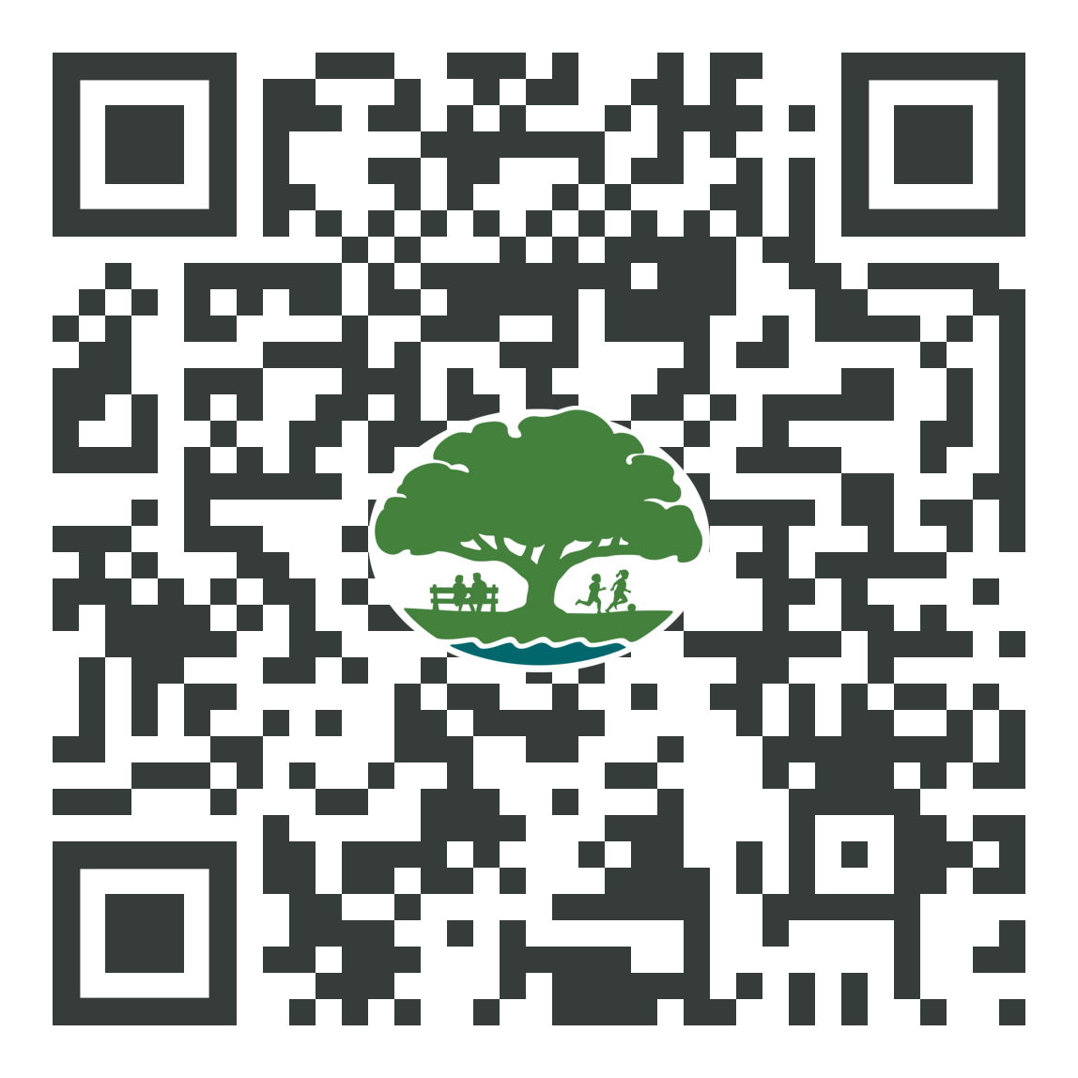
Share your thoughts with us.
Input Boards are around the room
Please share the online link below for your neighbors that could not attend this evening
Survey link will remain open until February, 2024

Slide 6
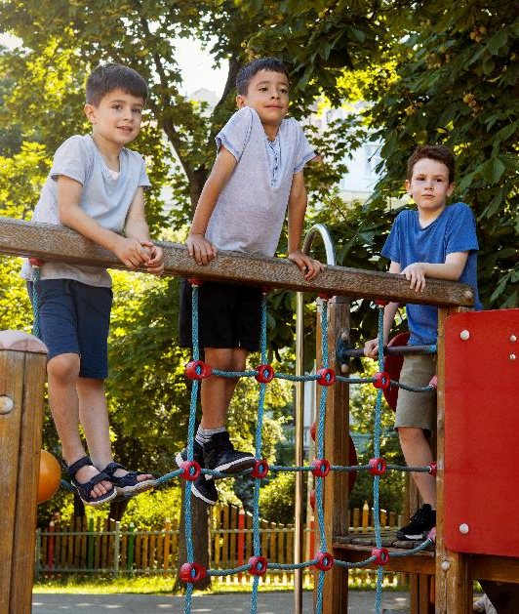
Questions?

Slide 7
Thank you!

