Slide 2
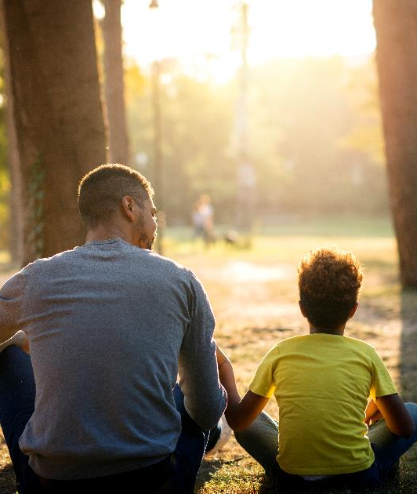
Henshaw Park
Community Input Session #2
April 24, 2024

Slide 3
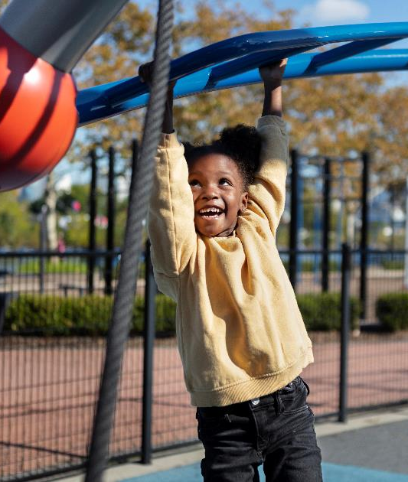
Agenda
Welcome
Review Survey #1 Results
Identify Survey #2 Questions
- What else would you like to see?
Timeline
Additional Comments and Closing

Slide 4
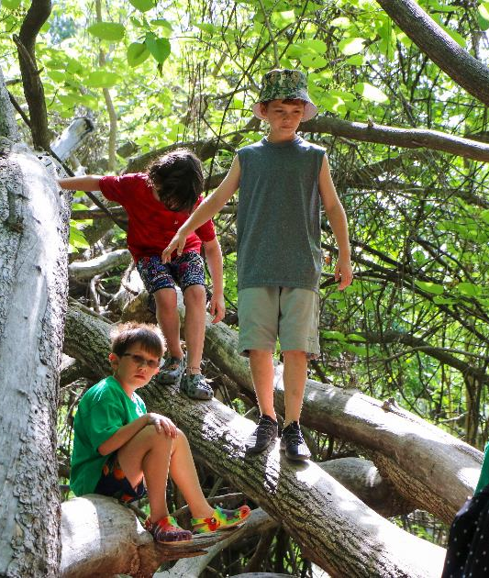
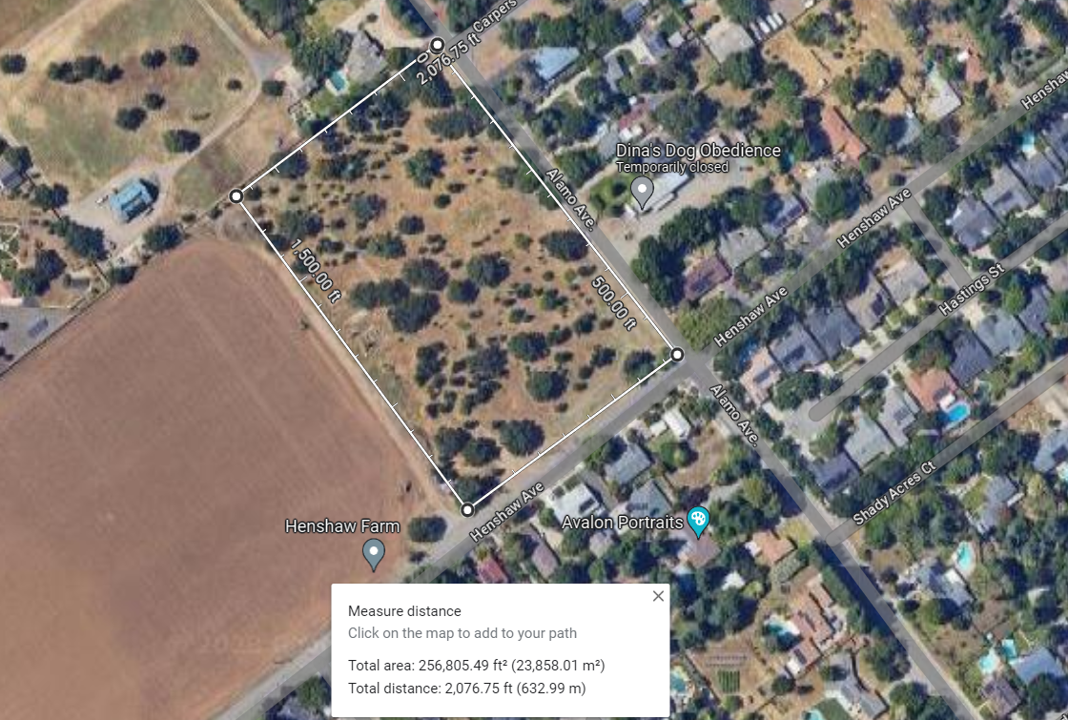
Henshaw Park Site
5.5 acres

Slide 5
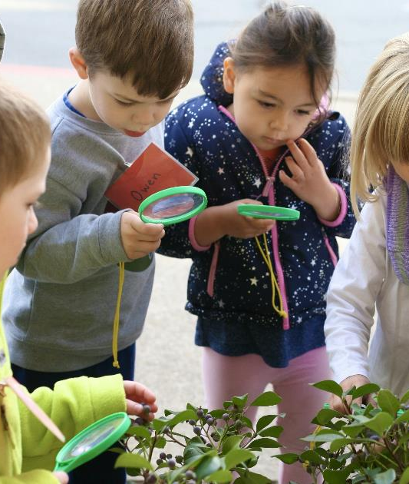
We have heard from you!
What sort of park amenities are you interested in?
Paths
Playgrounds
Trees and landscaping
Themes
Natural, modern, etc…
Shade

Slide 6
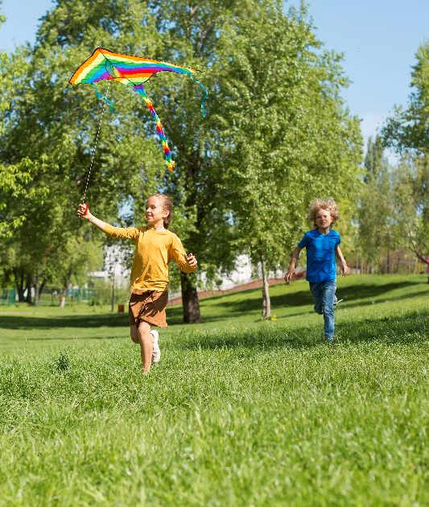
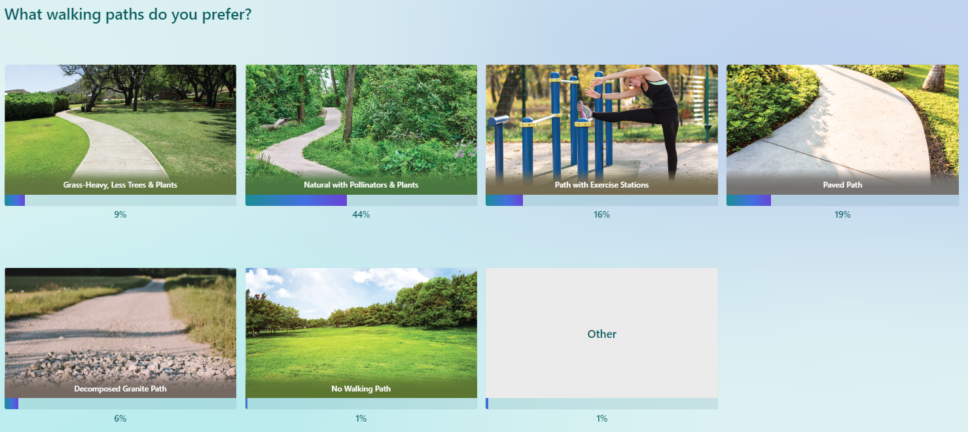
Walking Paths
Natural with Pollinators and Plants

Slide 7
Landscaping
Natural Landscape with lots of plants

Slide 8
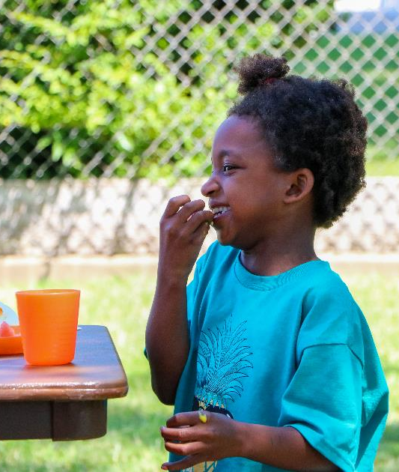
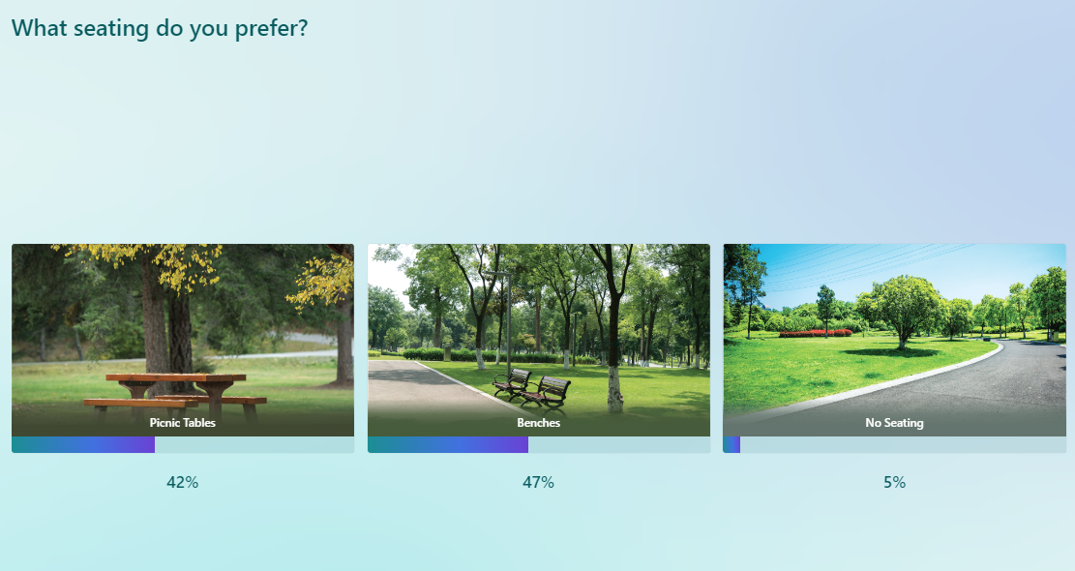
Seating
Benches
Picnic Tables

Slide 9
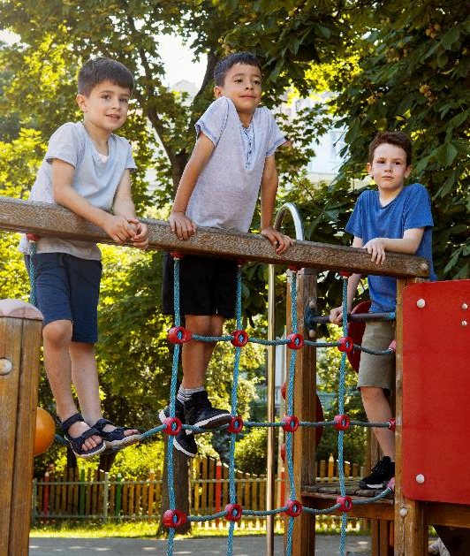
Play Equipment
Large Playground

Slide 10
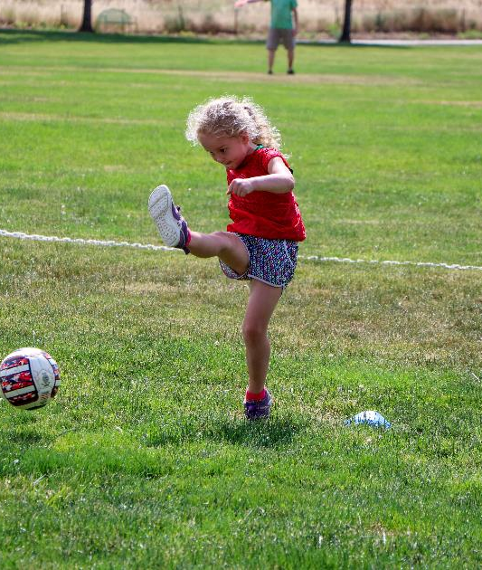
Shade Types
Variety including no shade in some areas

Slide 11
Important additional notes in the responses:
Additional Preferred Amenities:
Keep existing trees where possible
Soccer Fields
Basketball Courts
Grass
Multigenerational elements for kids and seniors
Additional Amenities with Mixed Preferences
Off Street Parking
Pickleball Courts and/or Tennis
Bathrooms
Entrance locations
Required Elements
Curb and Gutter improvements
ADA accessible parking stall(s) and ramps
Safe and accessible space for recreation*

Slide 12
Where do we go from here?
Phase Dates Project Activity
Pre-Design Nov 2023 1st Community Session
Apr 2024 Share Results at Community Session
May 2024 2nd Input Survey (online)
Jun/Jul 2024 Share Results at Community Session
Design Sep 2024 Request for Proposals (Architect)
Oct 2024 Select Designer
Jan 2025 Design Work
Feb 2025 Community input session(s)
Bidding Apr 2025 Bid for Construction
Construction Jun 2025 Construction Begins
Dec 2025/Jan 2026 Henshaw Park Opening!

Slide 13
Thank you!

